Slide 1
Stock price analysis of the past to predict the future.
By Ashwini, Ope, Amy, Jaejun, and Gayatri

Slide 2
Analysis and Findings:
We analyzed: FAANGG for Period: January 1,2017 - December 31,2017
Apple(AAPL)
Amazon(AMZN)
Facebook(FB)
Google(GOOG)
Netflix(NFLX) and
Gold(GLD)

Slide 3
Hypothesis: Future stock prices can be predicted from past performance.
Questions considered:
What is the everyday price-change?
What’s the change in stock’s price, and daily return average over time?
Is there any correlation between daily returns of different stocks?
How much value do we put at risk by investing in a particular stock?
How to determine the trend of the stock-price and predict the future?
How do we predict the future price?
Do social media (e.g., Twitter) impact daily changes in stock-price?

Slide 4
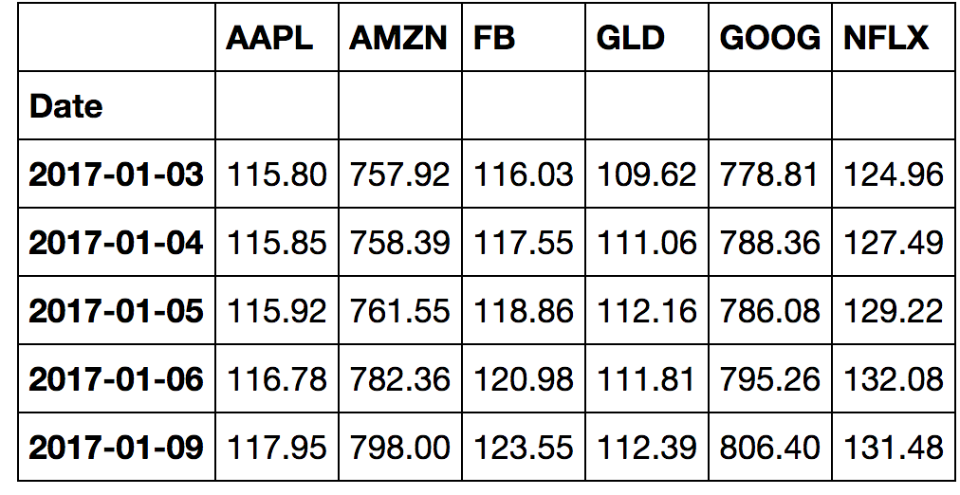
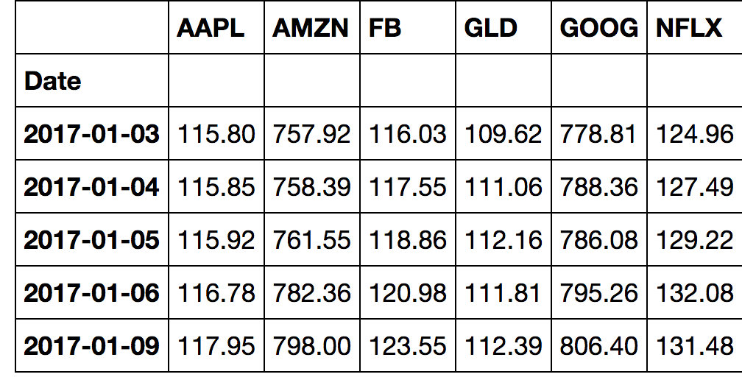
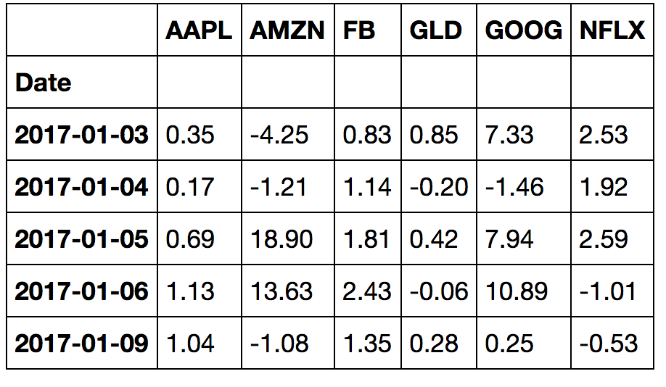
Opening , Closing Prices and the Daily Change tables
Opening Price
Closing Prices
Daily Change
Notes:
These are Opening, Closing prices

Slide 5
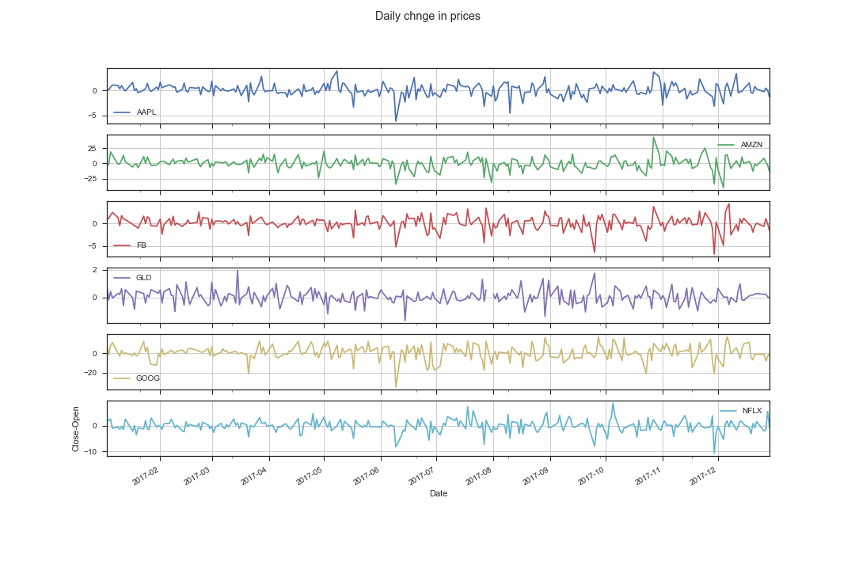
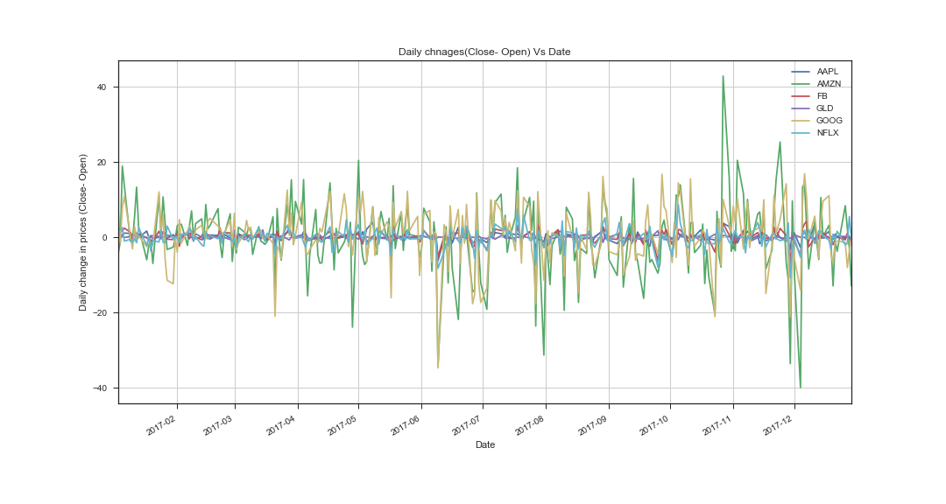
Plots/subplots: Change in prices Vs Date
Conclusion: From the graph, we can noticed that the, Google and Amazon stocks are fluctuating a lot. Amazon goes 40 points higher in the month of Nov2017 and goes down in 40 points in Dec.

Slide 6
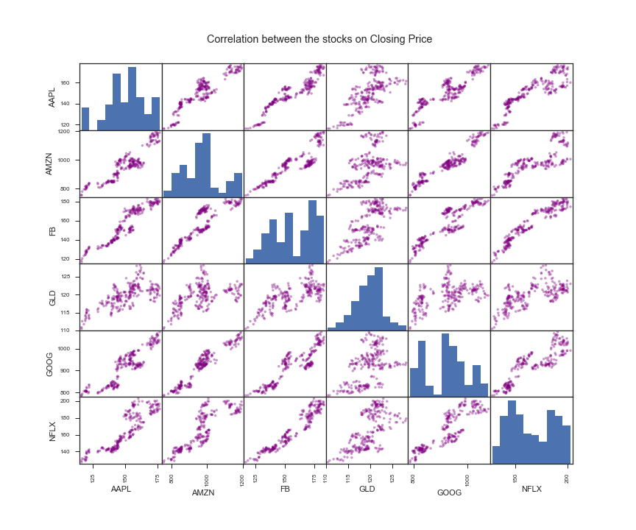
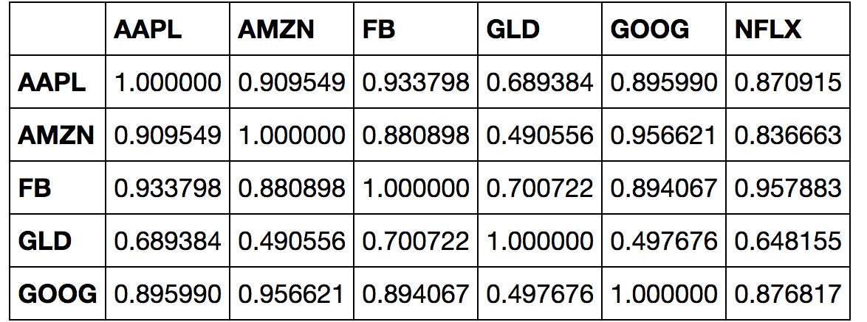
Correlation–coefficient table of closing price for all stocks:
All tech-stocks are strongly correlated to each other.
Gold(GLD) is relatively weakly correlated.
( Check out the table above and the next slid)
Hence GLD stock is one of the recommendations to have diversified well balanced portfolio.
Notes:
On this slid we can see the correlation-coefficient for all stocks.
From the matrix, it is pretty clear that the Closing Prices of the stocks do depend on one another.
i.e all tech stocks are more or less positively correlated to each other
FB prices are strongly positively correlated to AAPL,AMZN,GOOG and NFXL, except GLD.
In fact, whereas the Gold(GLD) prices are not getting affected by the prices of the other Tech stocks.
This indicates that there is a weak correlation between GLD and other stocks in the list. Take a close look at it on next slid.

Slide 7
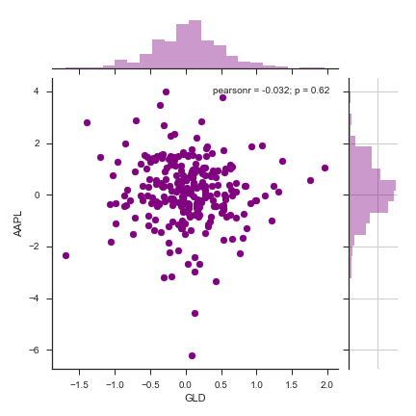
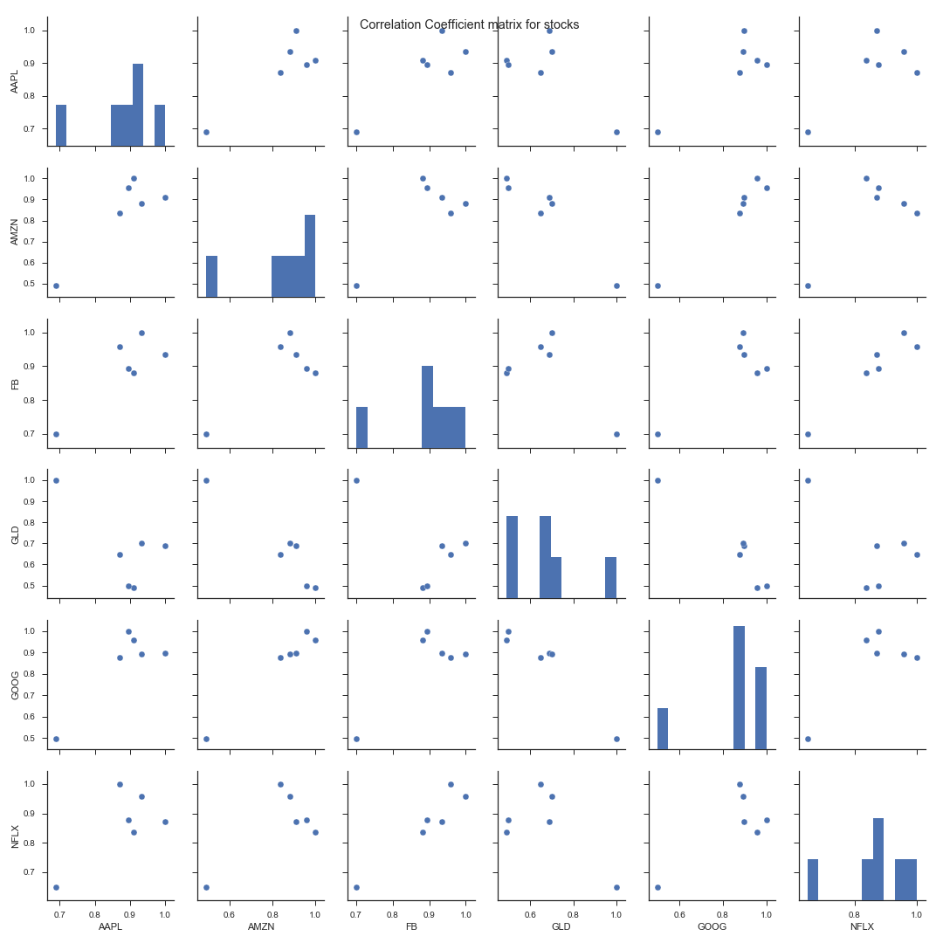
Correlation and Correlation -coefficient matrix for stocks:
Correlation-coefficient matrix
Pearson r = -o.032, p = 0.62
Low p-value Strong correlation and vice-versa.
GLD is weakly correlated to AAPL( p-value is high)
Notes:
Why buying a Gold stock is recommended?
So, buying GLD stocks will be a good idea to have diversified well-balanced portfolio.
Pearson r = -o.032, p = 0.62
(GLD is negatively correlated to AAPL)
p is the corr-coeff’s probability that the relationship between two variables is zero.
Strong relationship low p-values
See here. P =0.62. That indicates that there is very weak corr.

Slide 8
Value at Risk:
“Value at Risk:” Measure of the Risk of loss for an investment.
Estimates how much a set of investments might loose in a set time period in normal market conditions.
Value put at risk by investing in a particular stock:
Calculated by comparing its expected return with the standard deviation of daily returns.
Expected return = Mean of stock’s daily returns.
Notes:
So, let’s look at risk calculations for these stocks.
So, what is value at risk? It’s the measure of the Risk of loss for an investment. It estimates how much a set of investment might loose in a set time period in normal market conditions.
How much value do we put at risk by investing in a particular stock??
We will use various functions of pandas.

Slide 9
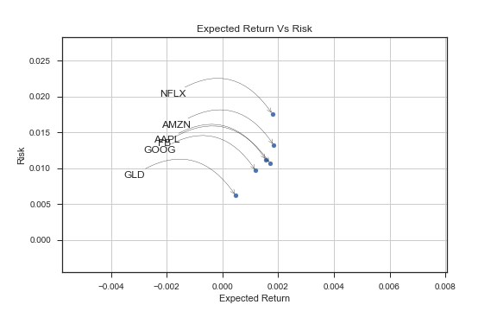
Risk Analysis:
We want high return, low risk stocks.
GLD seems to be the low risk low return socks in the entire list.
GOOG is the low risk low return among tech stocks.
NFLX has the highest return with highest risk.
Risk and returns for FB and AAPL are almost the same.
Notes:
“GOOG is the low risk low return among tech stocks.” This sounds counter intuitive, but, this is only relative to the stocks we have analyzed.☺

Slide 10
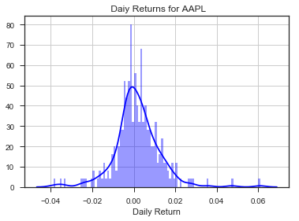
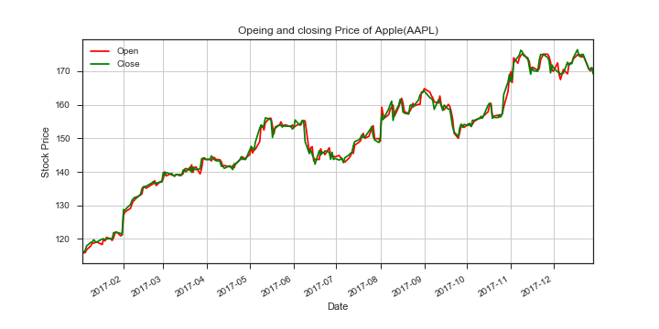
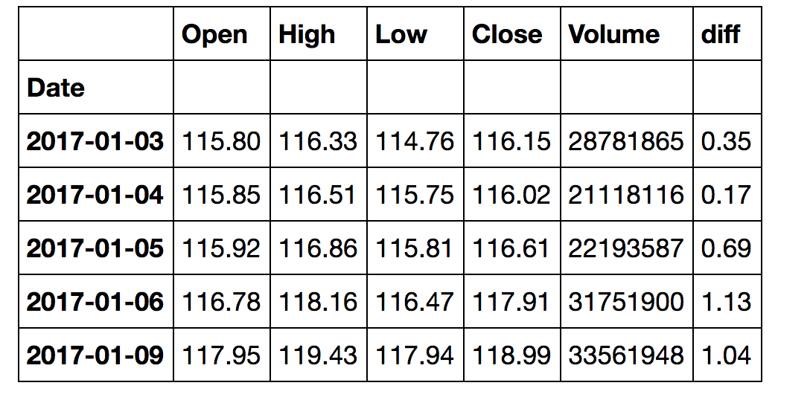
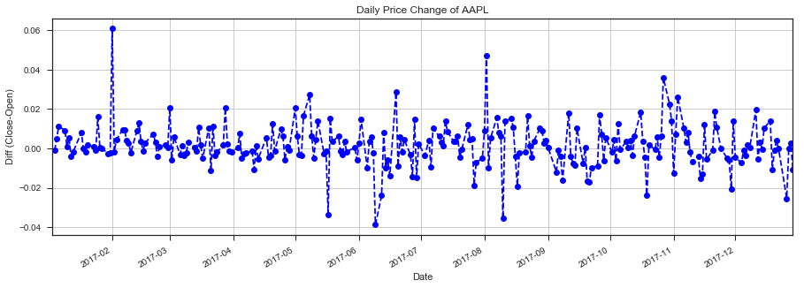
Analysis of AAPL stock
Notes:
Now we will analyze the individual stock. We have done it for Apple, and, the the process will be the same for the rest of the stock.

Slide 11
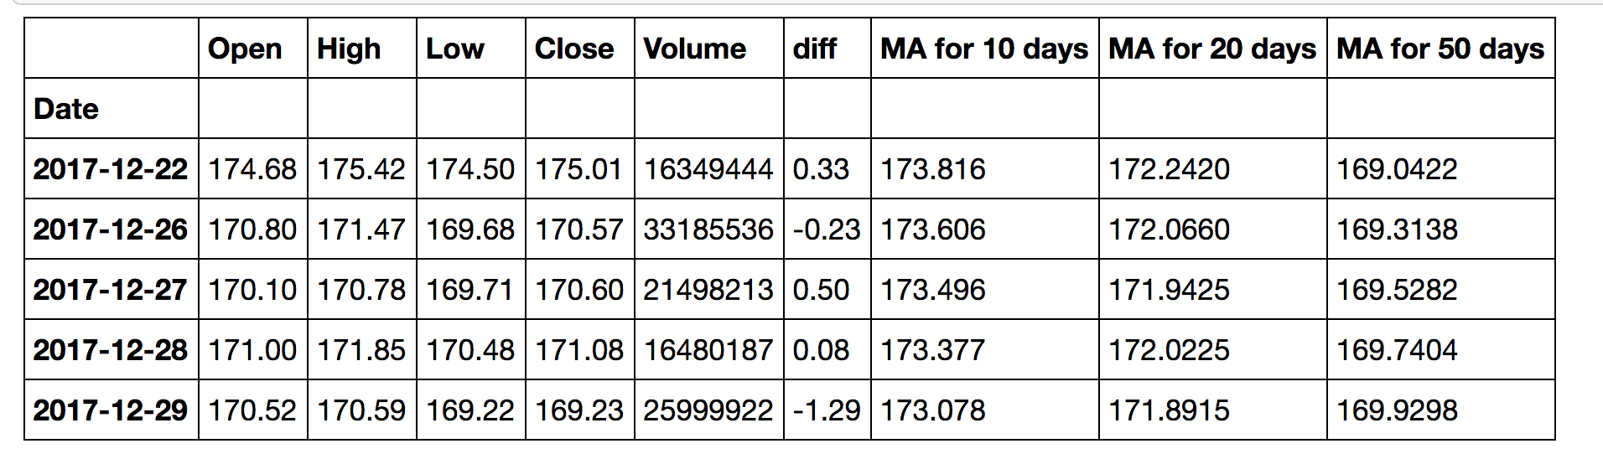
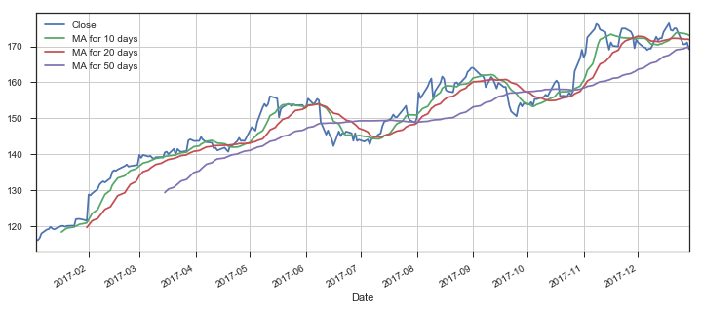
Moving Averages for AAPL:
Notes:
Moving average is the technique to get an overall idea of the trend in the data set.
It is extremely useful in forecasting the long-term trend.
So, according to this table, the predicted closing price for the AAPL is 173.816, 173.816, 173.816 respectively depending which MA we consider.
Now let’s see if our predictions are true.

Slide 12
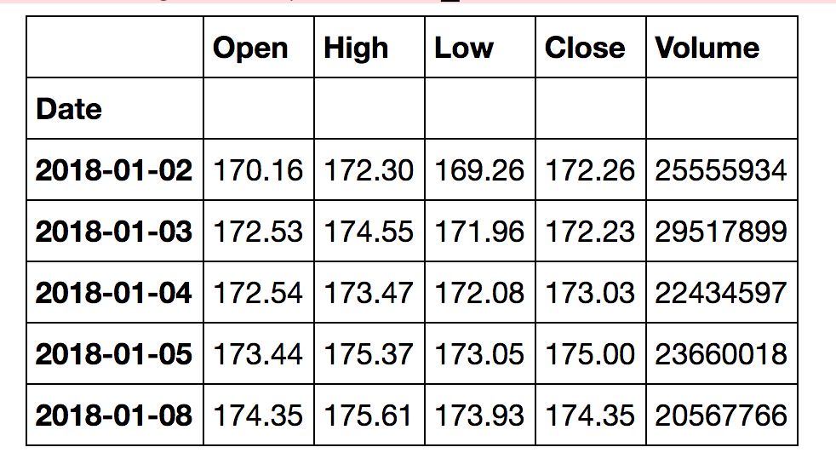
Comparison of AAPL
← AAPL Data for Jan,2018
← AAPL Data for Jan, 2018
Conclusion:
10-day and 20-day MA shows,
The Predicted price is very close to the Actual closing price of AAPL
Check:

Slide 13
Snippet of code:
We will find the Moving averages for Apple
AAPL_stocks_data = web.DataReader("AAPL", "google", start, end) AAPL_stocks_data.reset_index() AAPL_stocks_data["diff"]= AAPL_stocks_data["Close"]-AAPL_stocks_data["Open"] AAPL_stocks_data.head()
ma_day = [10,20,50] for ma in ma_day: column_name = "MA for %s days" %(str(ma)) AAPL_stocks_data[column_name] = AAPL_stocks_data['Close'].rolling(window=ma,center=False).mean()
AAPL_stocks_data[['Close','MA for 10 days','MA for 20 days','MA for 50 days']].plot(subplots=False,figsize=(12,5),grid = True) plt.savefig("aaaplmoveavg.png") plt.show()

Slide 14
Data Exploration and Clean-up :
Source to collect data: google finance, twitter
Data gathering:
Yahoo finance website is being deprecated.
Morningstar data was working fine, but was not in the form that we wanted.
Not able to retrieve data from Google finance on last minute, a day before the presentation.
So, chose Google Finance as data source.
Problems faced towards the end:
The data was working perfectly fine until the couple of days prior to the presentation.
Google Finance API started throwing errors for the “high volume of automated queries” towards the end of the project.
This resulted in not being able to complete Risk Analysis and Monte Carlo Simulation for Apple stock.
The data we got was pretty clean.
Notes:
All rows and columns have data, and, we didn’t have to clean it.
We wanted to analyzed these 5 stocks, and, analyze the APPL stock in detail using two methods: Moving Averages and Monte Carlo Analysis
Retrieving the data working fine until yesterday. Just one or two last additional tasks were left to do.
That’s when Google finance suddenly stopped cooperating.
There was a notice of Google Finance API started throwing errors for the “high volume of automated queries” towards the end of the project.
As a result of that I couldn’t retrieve the data for AAPLE.
I tried doing it using csv file, but some of the functions e.g df.pct_change() was not working.
The code for Moving Average was done earlier, but, I felt bad that we couldn’t complete the Monte Carlo Simulation and Risk Analysis for AAPL due to this issue.
Luckily, we the code uploaded on the repo. So we could make the slides for today’s presentation..☺

Slide 15
Twitter Sentimental Analysis for Stock Market
Question
Can twitter be used to predict stock market trend?
Stocks
FB, AAPL, AMZN, NFLX, GOOG
GLD
Initial problems
StockTwits API
Not easy to get, only assigned to approved developers
Can take days
Twitter
Twitter API data can only be obtained for the past 7 days (free version)
Therefore, analyzing old stock market data with twitter was challenging
Goal:
Analyze Price change in stocks over a time period
Collect and determine tweet polarity over the same period
Tweet Filter
VaderSentiment
Determine if tweet polarity affects stock price chage
Is there any correlation?

Slide 16
Symbol | Price Change (%) | Polarity
AAPL | 2.240 | 0.277
AMZN | 4.570 | 0.293
FB | 4.117 | 0.104
GLD | -0.005 | 0.292
GOOG | 6.042 | 0.203
NFLX | 7.576 | 0.007
There was negative correlation between
stock price change and tweet polarity
This suggests that twitter may not be the
best approach to predict stock market trends
Limitations of our data
Only limited to tech stocks
Only big stocks with large market cap
Multiple days
Intra day data may be a better predictor

Slide 17
Conclusion:
Based on our analysis, the hypothesis that future stock prices can be predicted from past performance is true.
There was negative correlation between Stock Price change & Tweet polarity.
This suggests, Twitter may not be the best approach to predict stock market trends.

